Slide 1
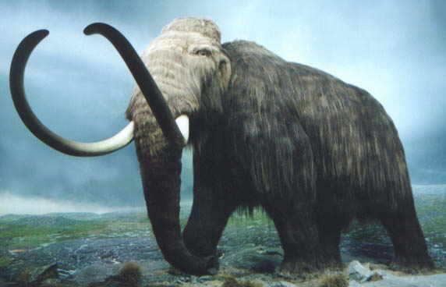
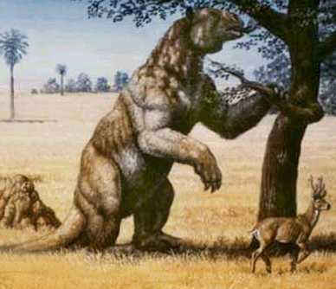
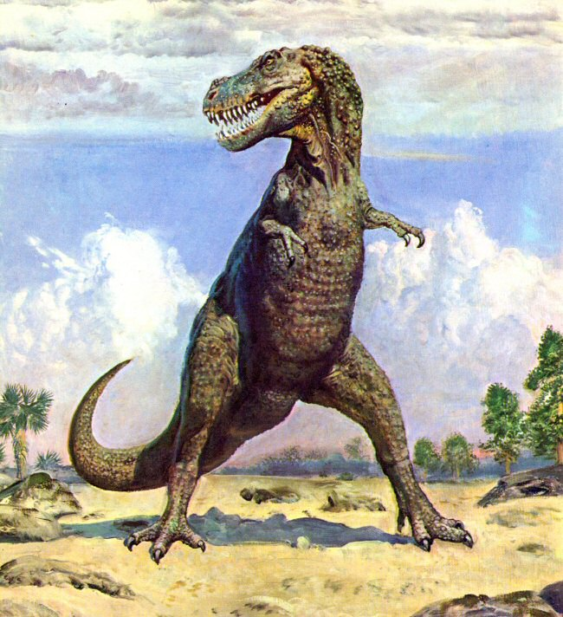
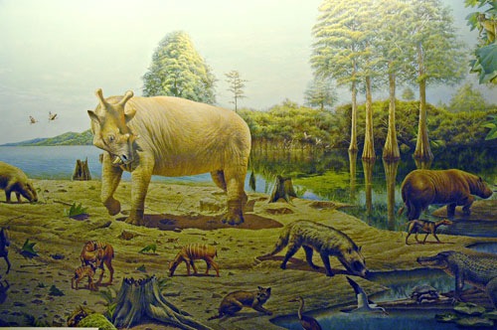
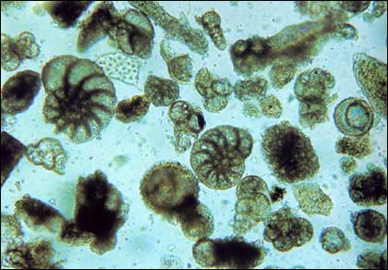
Studying Paleoclimate to Reduce Climate Uncertainty
Dorian S. Abbot

Slide 2
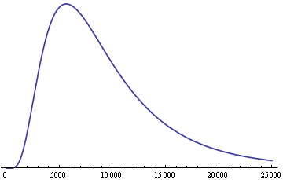
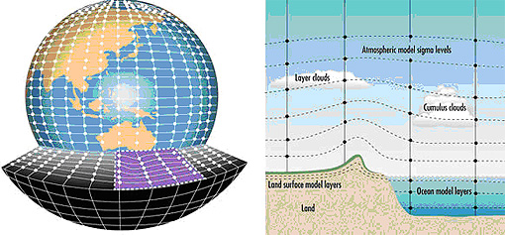
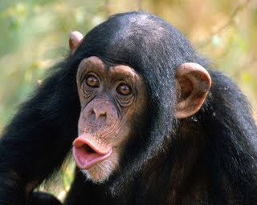
Why do we study paleoclimate?
To improve climate models and decrease climate uncertainty
Probability
Probability
Severity of Future Climate Change
It’s fun!

Slide 3
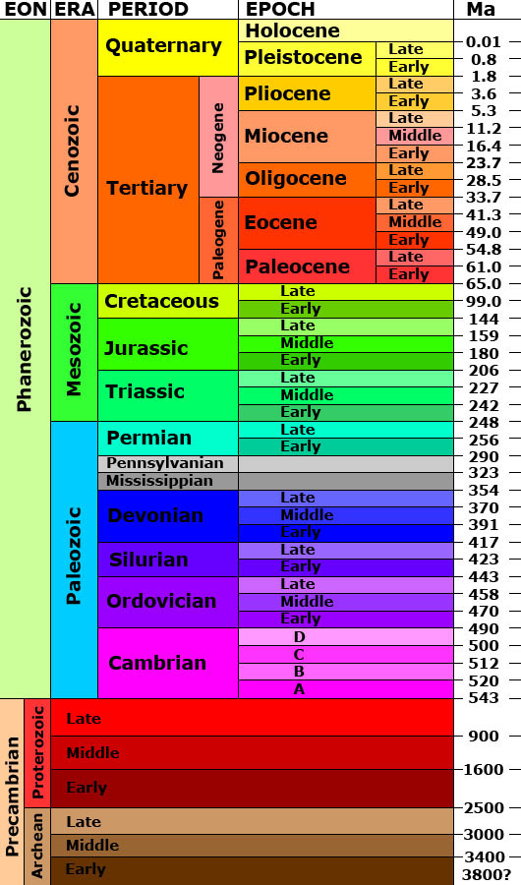
What timescales are we talking about?
Millions of years!!!
I. Glacial cycles
II. Equable climates
Time
Snowball Earth Episodes

Slide 4
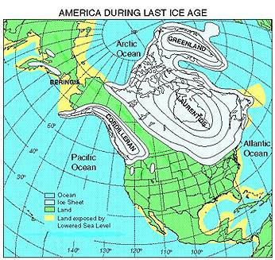
I. Glacial Cycles

Slide 5
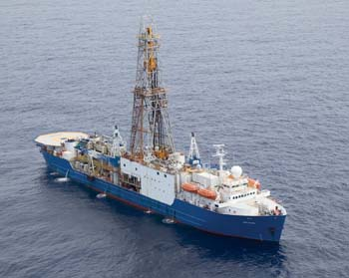
We can reconstruct climate using plankton fossils.
Now!
The distant past
Foraminifera
Drill
Die and settle
to bottom
Mud

Slide 6
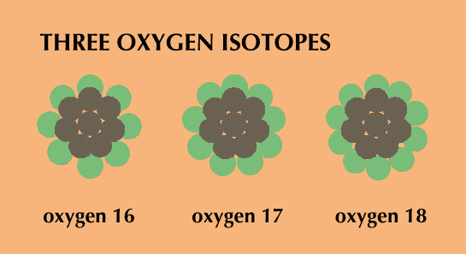
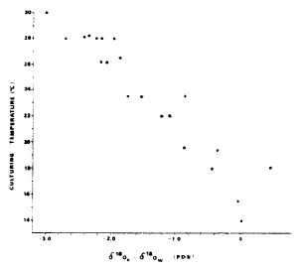
The oxygen isotopic ratio in the shells of foraminifera tells us about ocean temperatures and global ice volume.
Temperature Fractionation
30
T [°C]
14
-3.0
δ¹⁸O_{cc}- δ¹⁸O_{sw}
0.0
[Erez and Luz, 1983]

Slide 7
The climate of the past few million years has been characterized by glacial cycles.
warm,
less ice
~100 kyr cycles
~40 kyr cycles
cold,
more ice
Time before present (kyr)
[Lisiecki and Raymo, 2005]

Slide 8
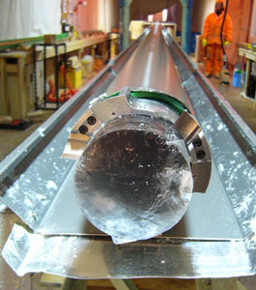
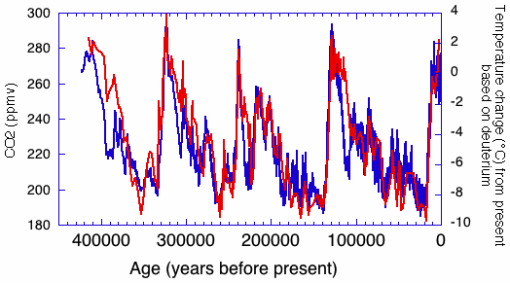
Air bubbles in Greenland and Antarctic ice give us a similar temperature story and yield atmospheric composition.
Time before present (kyr)

Slide 9
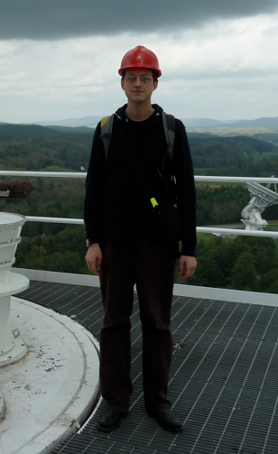
Now I point out a paleoclimate statistical problem (and get myself in trouble).
Ask this guy questions...
Eric Switzer
Kavli Institute for Cosmological Physics
Canadian Institute for Theoretical Astrophysics

Slide 10
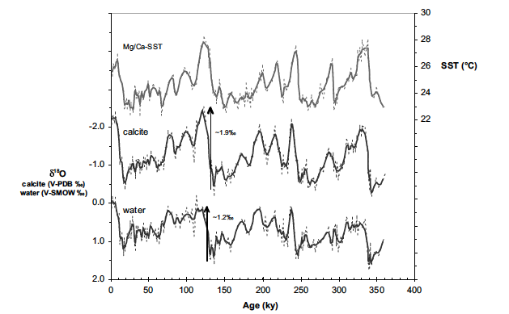
If we had an independent way to determine temperature (Mg/Ca) we could say something about sea level.
[Lea et al., 2002]

Slide 11
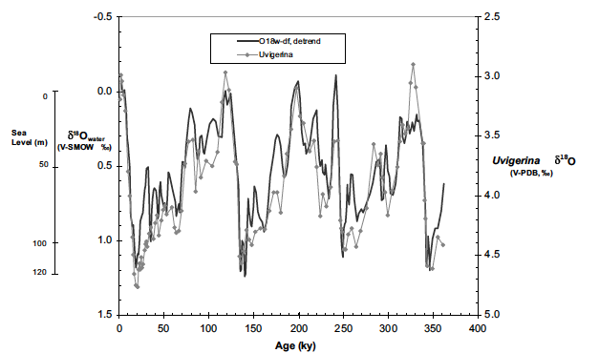
Often error is unreported, or one measurement error value is given for a paleoclimate timeseries.
[Lea et al., 2002]

Slide 12
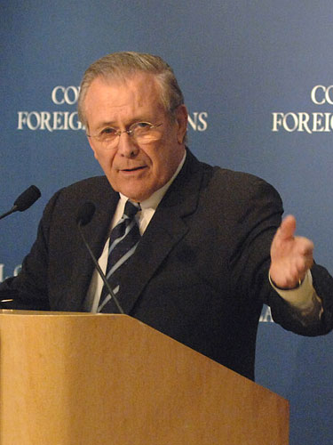
As we know,
There are known knowns.
There are things we know we know.
We also know
There are known unknowns.
That is to say
We know there are some things
We do not know.
But there are also unknown unknowns,
The ones we don't know
We don't know.

Slide 13
Calibration error may be much larger than measurement error.

Slide 14
The MCMC reconstruction of SST from Mg/Ca including error is more informative than the original reconstruction.

Slide 15
Using MCMC we can reconstruct error bars on δ¹⁸O seawater including calibration error as a function of time.

Slide 16
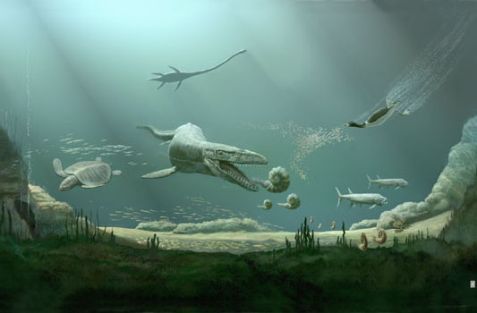
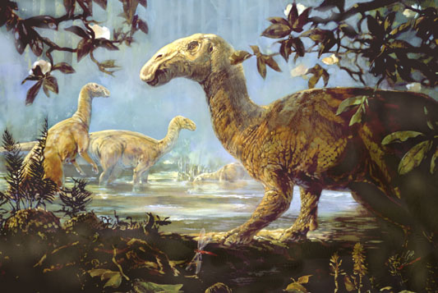
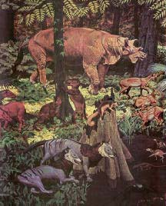
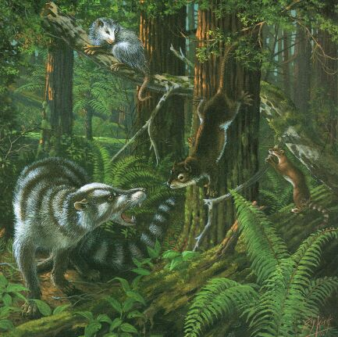
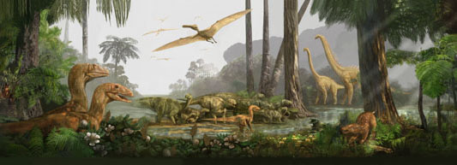
II: Equable climates

Slide 17
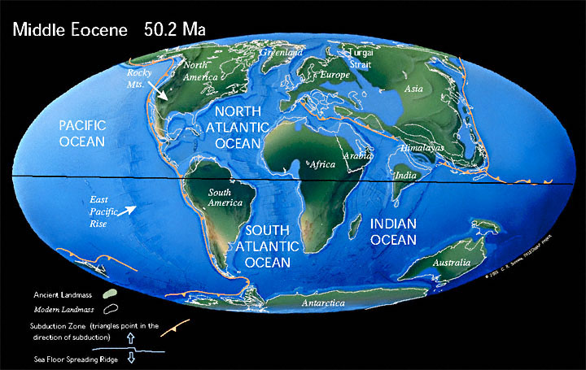
The continental position was similar during the Eocene.

Slide 18
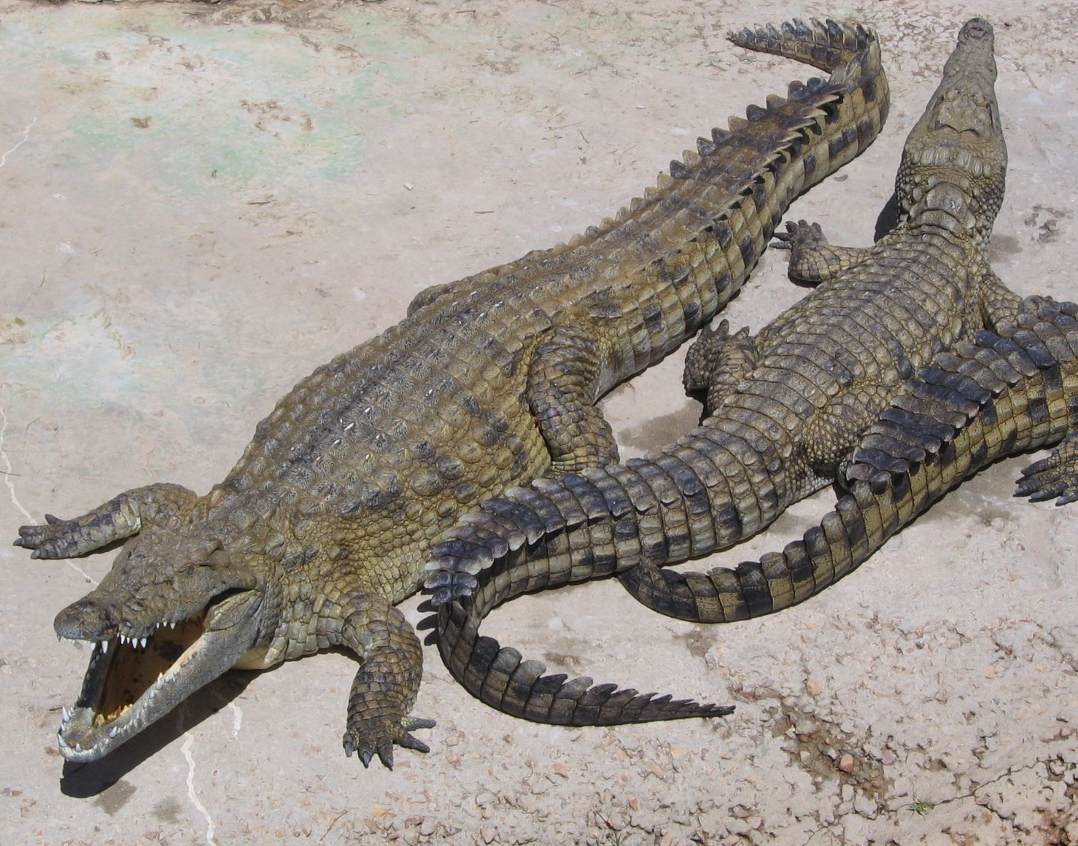
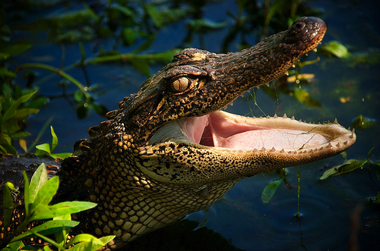
One climate reconstruction method is to look for the nearest living modern analog of fossils.

Slide 19
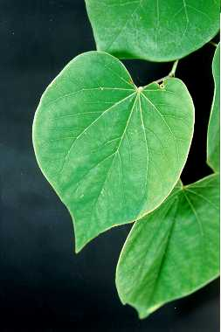
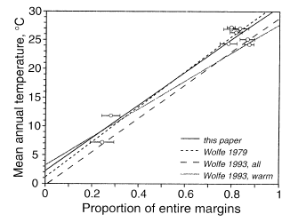
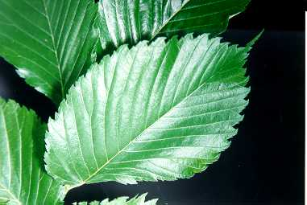
The proportion of smooth leaf margin species in a forest is correlated with temperature.
Toothed margin
Smooth margin
[Wilf, 1997]

Slide 20
Shallow and deep foraminifera can be used to reconstruct climate for the past 100 million years.
Shallow – planktonic foraminifera
Deep – benthic foraminifera
Mud

Slide 21
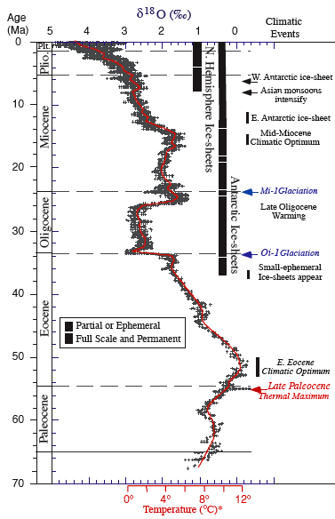
Benthic foraminifera show that the climate has gradually cooled for the last 50 millions years.
[Zachos et al., 2001]

Slide 22
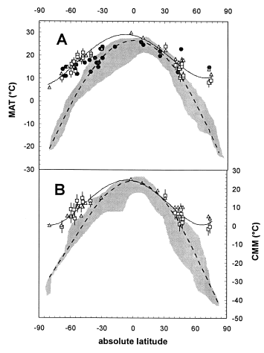
During equable climate periods the high latitudes were much warmer, esp. during winter, relative to the tropics.
Modern
Eocene
[Greenwood and Wing, 1995]

Slide 23
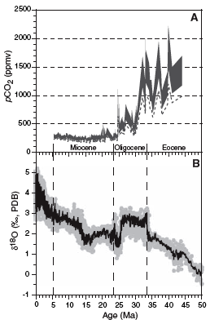
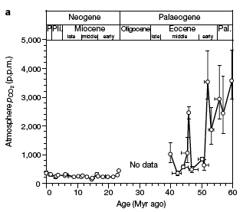
We have very little idea what the atmospheric CO₂ concentration was more than 800,000 years ago.
[Pagani et al., 2005]
[Pearson and Palmer, 2000]

Slide 24
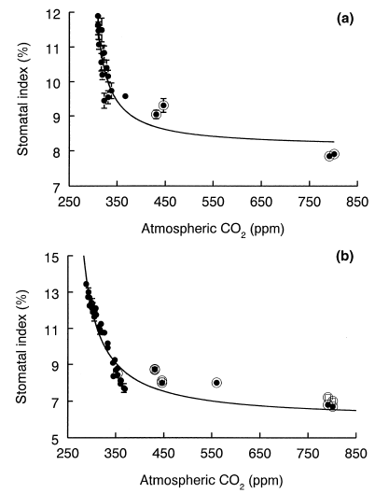
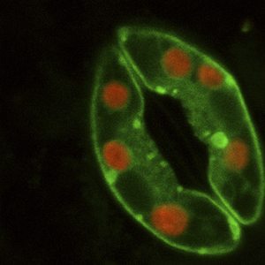
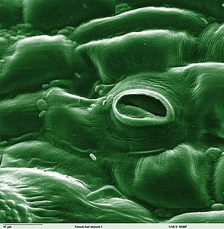
The percentage of leaf epidermal cells that are stomata is sometimes used to reconstruct paleo-CO₂.
[Beerling and Royer, 2002]

Slide 25
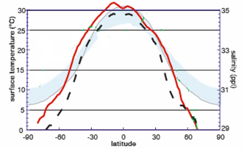
Coupled global climate models traditionally had difficulty reproducing Eocene proxy reconstructions.
Modern Model SST
Eocene Model SST
Eocene Proxy SST
[Huber and Sloan, 2001]

Slide 26
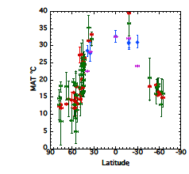
Models do reproduce Eocene temperature gradients if you believe it was much hotter in tropics.
model sea
data sea
model land
data land
[Huber and Caballero, 2011]

Slide 27
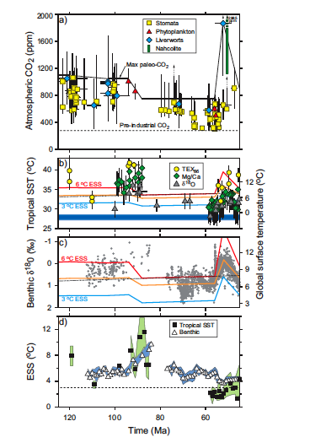
Comparison of MCMC reconstruction of SST from Mg/Ca including error to original reconstruction
[Royer et al., rejected]

Slide 28
Most of the uncertainty in climate models comes from subgrid-scale “physical” parameterizations.

